Slide 1
Two Algorithms for LCS Consecutive Suffix Alignment
Gad M. Landau Eugene Myers and Michal Ziv-Ukelson
CPM 2004
Presented by Jian-Fu Dong

Slide 2
Abstract(1/2)
The problem of aligning two sequences A and B to determine their similarity is one of the fundamental problems in pattern matching. A challenging, basic variation of the sequence similarity problem is the incremental string comparison problem, denoted Consecutive Suffix Alignment, which is, given two string A and B, to compute the alignment solution of each suffix of A versus B.

Slide 3
Abstract(2/2)
Here, we present two solutions to the Consecutive Suffix Alignment Problem under the LCS metric. The first solution is an O(nL) time and space algorithm for constant alphabets, where n is the size of the compared strings and L<=n denotes the size of the LCS of A and B
The second solution is an O(nL+nlog|Σ|) time and O(L) space algorithm for general alphabets, where Σ denotes the alphabet of the compared string

Slide 4
Preliminaries-Problem Definition
Problem Definition : given two strings A and B, to compute the alignment solution of each suffix of A versus B

Slide 5
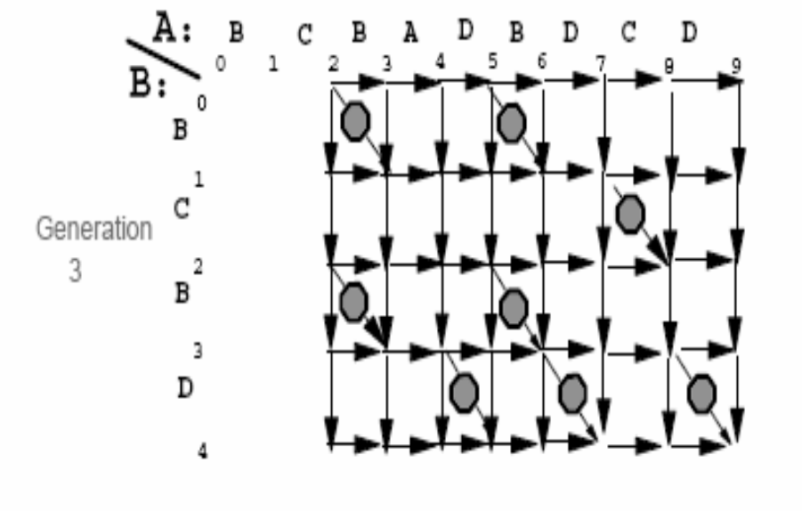
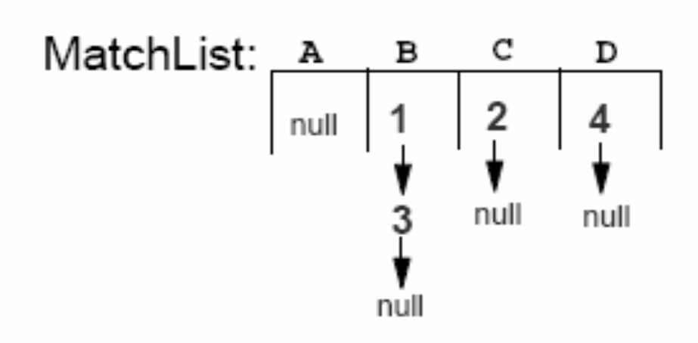
Preliminaries-MatchList
MatchList(j) stores the list of indices of match points in column j of DP, sorted in increasing row index order

Slide 6
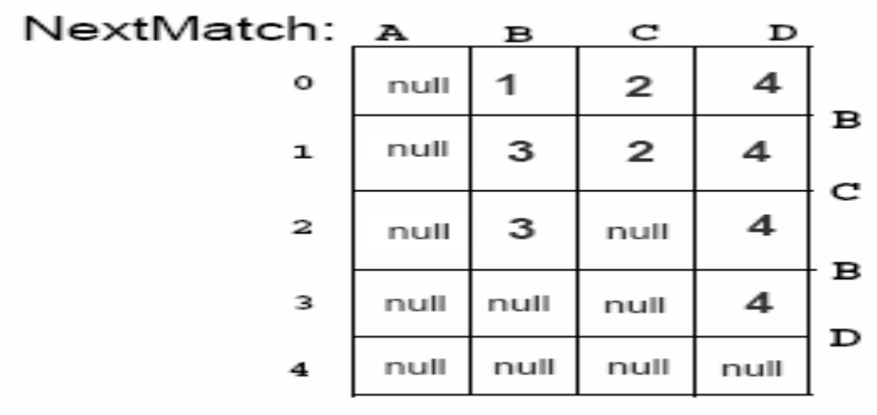
Preliminaries-NextMatch
NextMatch(i,A[j]) denotes a function which returns the index of the next match point in column j of DP with row index greater than i, if such a match point exists. If no such match point exists, the function returns NULL

Slide 7
Preliminaries-Partition Point
P^{k} denotes the set of partition points of DP^{k}, where partition point P^{k}_{j} [v] ,for k= 1…n, j= k…n, v = 0…L_{k}, denotes the first entry in column j of DP^{k} which bears the value of v.

Slide 8
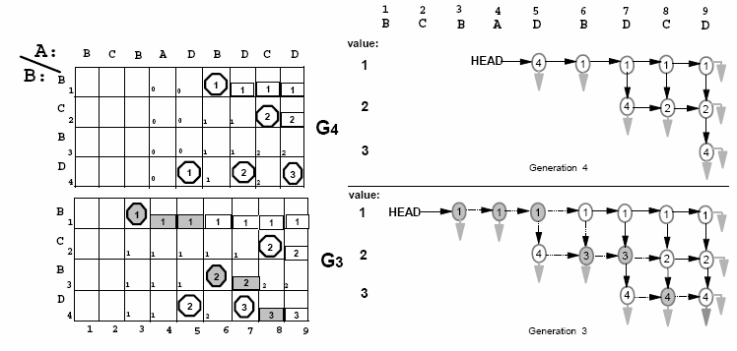
First Algorithm

Slide 9
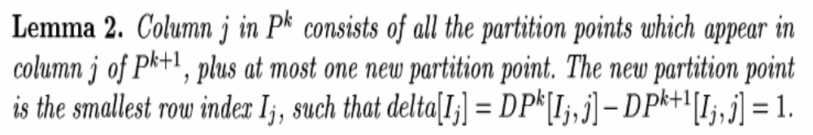
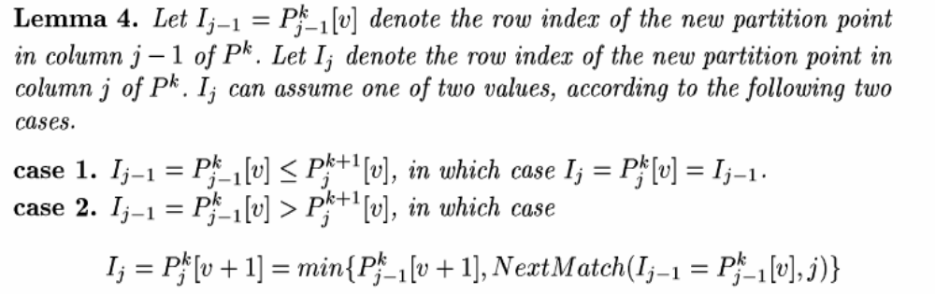
Computing the New Partition Points of Column j of P^{k}(1/3)

Slide 10
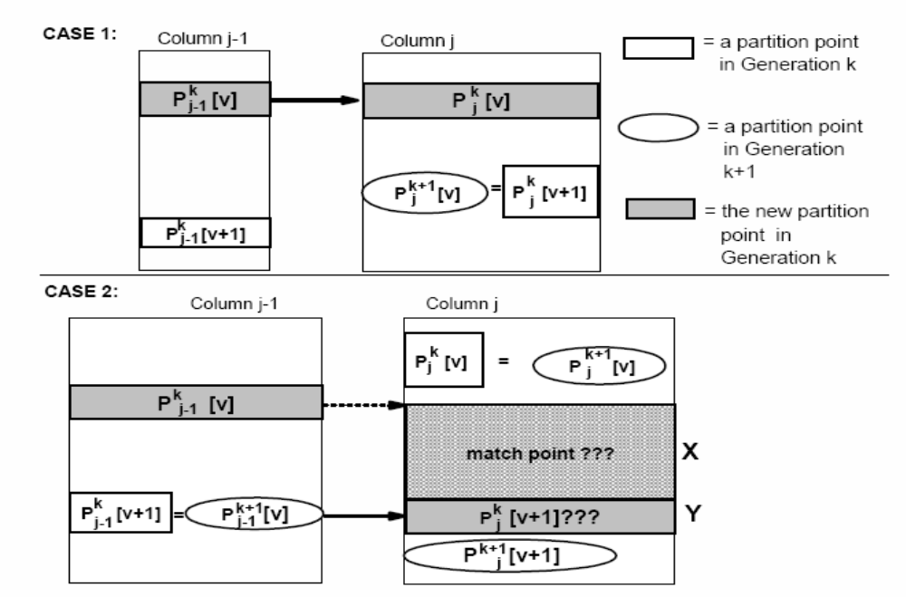
Computing the New Partition Points of Column j of P^{k}(2/3)

Slide 11
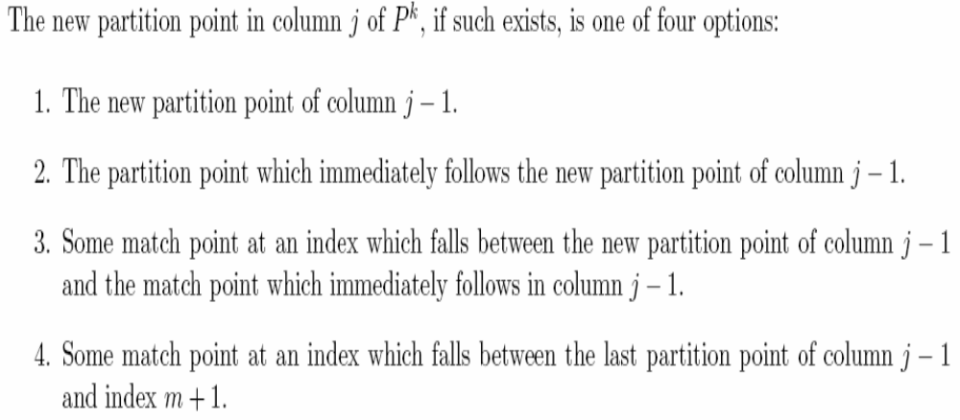
Computing the New Partition Points of Column j of P^{k}(3/3)

Slide 12
Time Complexity
Preprocessing stage : NextMatch table is construct in O(n|Σ|) time.
Updating P from P^{n} to P¹ : O(n²)

